Slide 1
Slide 1-1

Slide 2
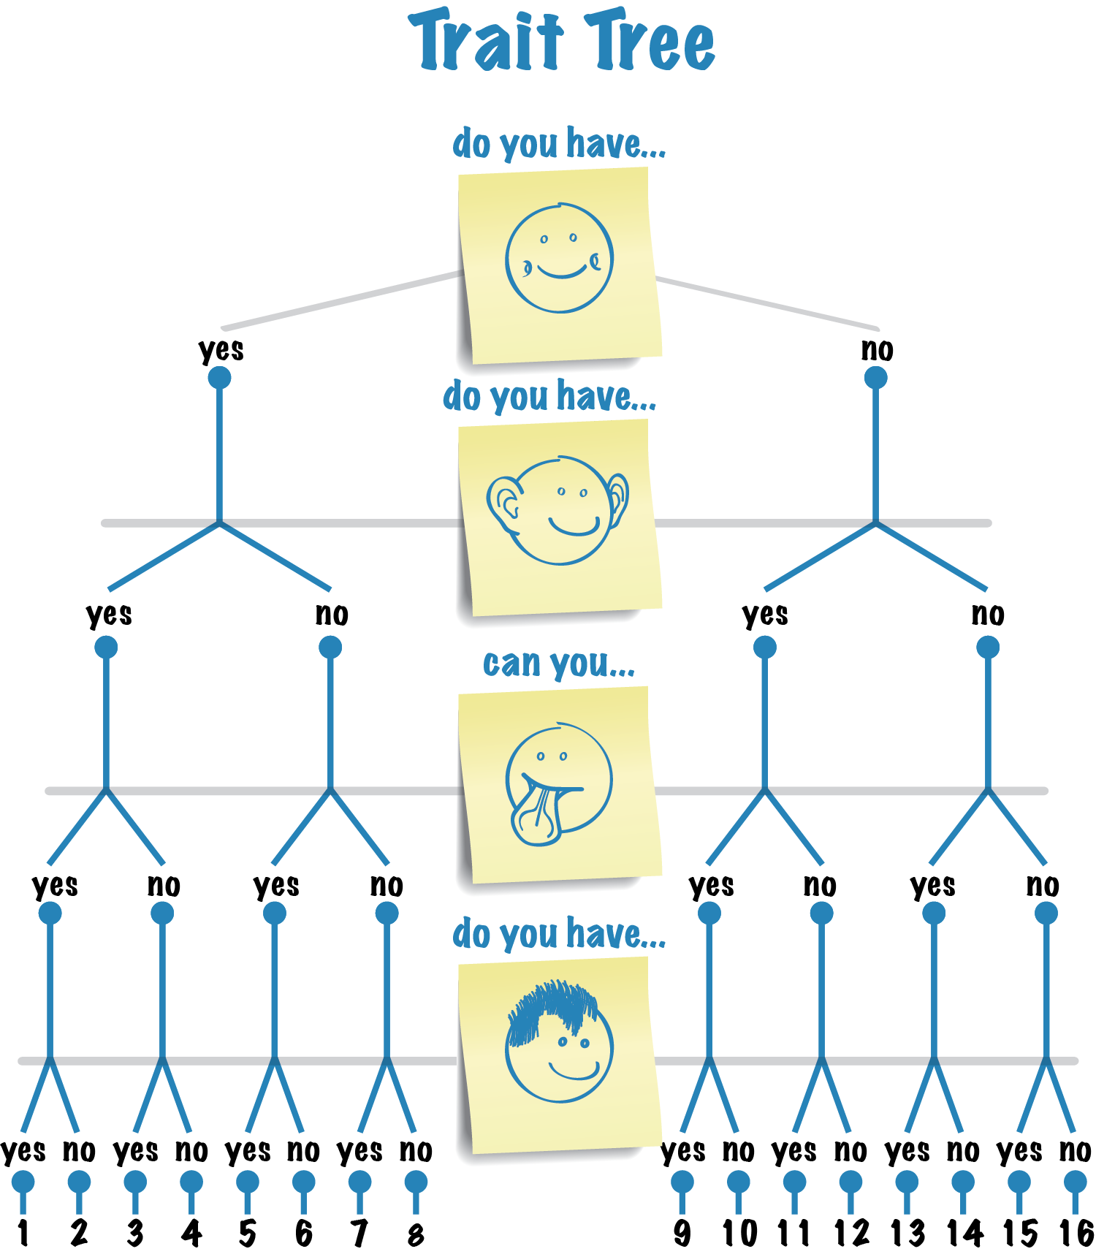

Slide 3
Slide 1-3

Slide 4
Slide 1-4

Slide 5
Slide 1-5

Slide 6
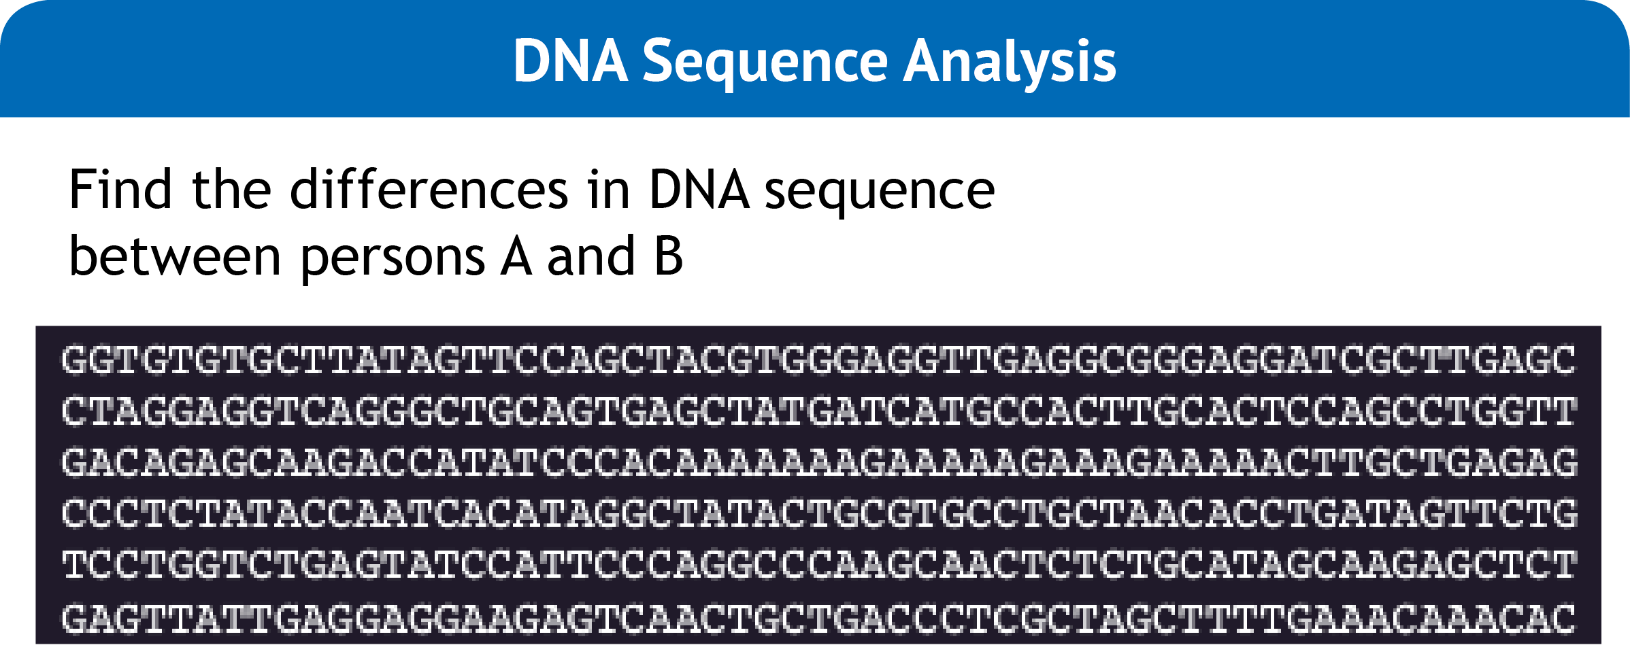
Slide 1-6

Slide 7
Slide 1-7

Slide 8
Slide 1-8

Slide 9
Slide 1-9

